Slide 1
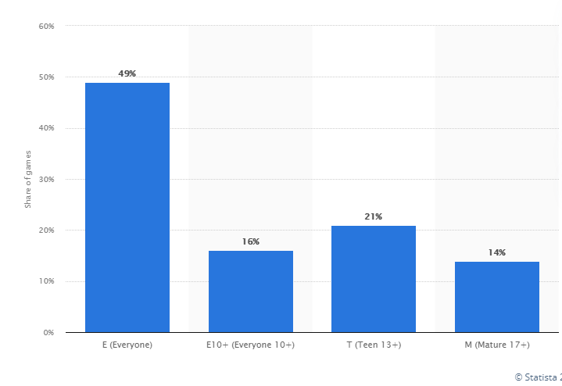
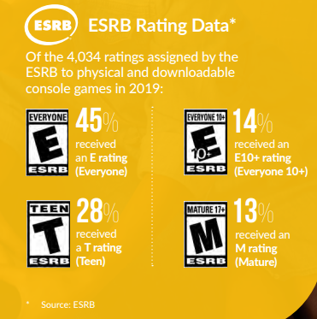
Background
• U.S. computer and video games by rating 2020 | Statista
2020-ESA_Essential_facts_070820_Final_lowres.pdf (theesa.com)

Slide 2
Problem
We want to predict our game´s ESRB scores so we can get support from a videogame Publisher to distribute our game phisically worldwide, Since the Publisher would be more interested on a lower ESRB rating to maximize potential buyers range

Slide 3
The database
We used kraggle database for video games rating:
https://www.kaggle.com/imohtn/video-games-rating-by-esrb
The data contains information from 1895 games with 34 ESRB rating content (features)

Slide 4
The model

